Slide 1


Review-I
Ear-Wearable SpO₂ and Heart-Rate Monitoring Device for Low-Ventilation Area Workers
AY 2025-26
Capstone Project – Introduction (PROJ2999)
GITAM (Deemed-to-be) University
Department of Electrical Electronics and Communication Engineering
Project Team:
Monisha H S – BU22EECE0100439
Prajwal Shetty – BU22EECE0100434
Project Mentor:
Mr. Kshitij Shakya
Project In-charge:
Mr. Jaya Praksh Sahoo
www.gitam.edu

Slide 2
Objective and Goals
Objective
This project aims to develop a compact ear-wearable device that continuously measures blood oxygen saturation (SpO₂) and heart rate of workers in low-ventilation environments such as mines, tunnels and factories.
Using a MAX3010x optical sensor mounted in an ear clip and a microcontroller (Arduino/ESP32), the system acquires photoplethysmography (PPG) signals from the ear.
A simple AI/ML algorithm analyses the signals in real time to distinguish genuine drops in SpO₂ from motion artefacts, and triggers LED/buzzer alerts only when a verified low-oxygen event occurs.
The goal is a portable, comfortable and reliable safety monitor that reduces false alarms while improving worker health monitoring.
Goals
Main Goals
Develop hardware prototype using MAX3010x sensor and Arduino/ESP32
Collect and analyze PPG signals from the ear and Train ML models for noise removal & anomaly detection
Provide real-time alerts via buzzer/LED for safety and Ensure comfort and portability for continuous use
Additional Goals
Add wireless/cloud connectivity for supervisor monitoring
Optimize power consumption for longer operation
Create a dashboard/app for real-time visualization of workers’ vitals

Slide 3

Project Plan

Slide 4
Literature Survey
Key Publications (IEEE & Scholarly Papers)
Title | Authors | Advantages / Why Useful | Key Takeaways
Wearable Photoplethysmography for Cardiovascular Monitoring | P. H. Charlton, P. A. Kyriacou, et al. | A comprehensive survey in IEEE on how PPG is used in wearables | Explains sensor design, signal processing challenges, motion artefact handling, and future research directions for wearable PPG systems
Photoplethysmography in Wearable Devices | K. B. Kim et al. | Good coverage of fundamentals and trends of PPG in wearables | Describes how PPG works, challenges in wearable context (motion, ambient light), multi-wavelength setups
In-Ear SpO₂: A Tool for Wearable, Unobtrusive Monitoring of Core Blood Oxygen Saturation | H. J. Davies, I. Williams, N. Peters, D. Mandic | Shows feasibility of ear canal SpO₂ measurement compared to finger | Found RMS error ~1.47%, mean offset ~0.23%, and ~12.4 s faster detection in ear vs finger; also discusses lower amplitude in ear signals
Development of a Wearable Reflection-Type Pulse Oximeter | P. P. Banik et al. | Demonstrates motion-aware SpO₂ and HR measurement in a wearable device | Reports performance under motion: 4.5% MAPE, 3.66 bpm MAE in motion, and ~98.96% SpO₂ accuracy without motion
Machine Learning-Based Respiration Rate and Blood Oxygen Estimation | M. N. I. Shuzan et al. | Combines PPG features with ML to predict both respiration rate and SpO₂ | Shows the effectiveness of ML models on biosignal data to jointly estimate multiple vital parameters
Reduction of Motion Artifacts from PPG Signals using Learned Convolutional Sparse Coding | Giulio Basso, Xi Long, Reinder Haakma, Rik Vullings | A novel method for PPG denoising using a blend of sparse coding + learning | Demonstrates improved SNR and lower error in heart-rate estimation under motion compared to conventional methods

Slide 5
Literature Survey
Key Resources (Datasheets / Whitepapers / Application Notes)
Existing Implementations
Products:
OxiWear – FDA-approved ear-worn pulse oximeter
Masimo MightySat / Temple-worn sensors
Smart Earbud with built-in SpO₂ monitoring
Headband/Temple-mounted SpO₂ monitors
Resource | What It Provides | How It Helps You
MAX3010x datasheet (Maxim / Analog Devices) | Sensor specifications (wavelength, LED currents, timing, sensitivity) | Use for hardware design, setting LED currents, understanding optical constraints
Application note on wearable PPG / SpO₂ sensor integration | Best practices on layout, calibration, noise filtering | Helps you integrate sensor properly and avoid common pitfalls
Signal processing / filtering whitepapers | Methods for motion artefact removal, adaptive filtering, wavelet denoising | Use to design your preprocessing pipeline before feeding to ML model
ML in biomedical sensor whitepapers | Articles on applying ML (SVM, Random Forest, Deep Learning) to physiological signals | Helps you pick a model architecture and strategy for classification/regression

Slide 6
Literature Survey
Open-Source / GitHub Projects
Arduino MAX3010x libraries
DIY ear-clip PPG sensor projects
Earbud pulse oximeter prototype (MAX30102 + Arduino)
Wearable PPG toolkit for signal processing
BLE-enabled ear-lobe SpO₂ sensor (student project)

Slide 7
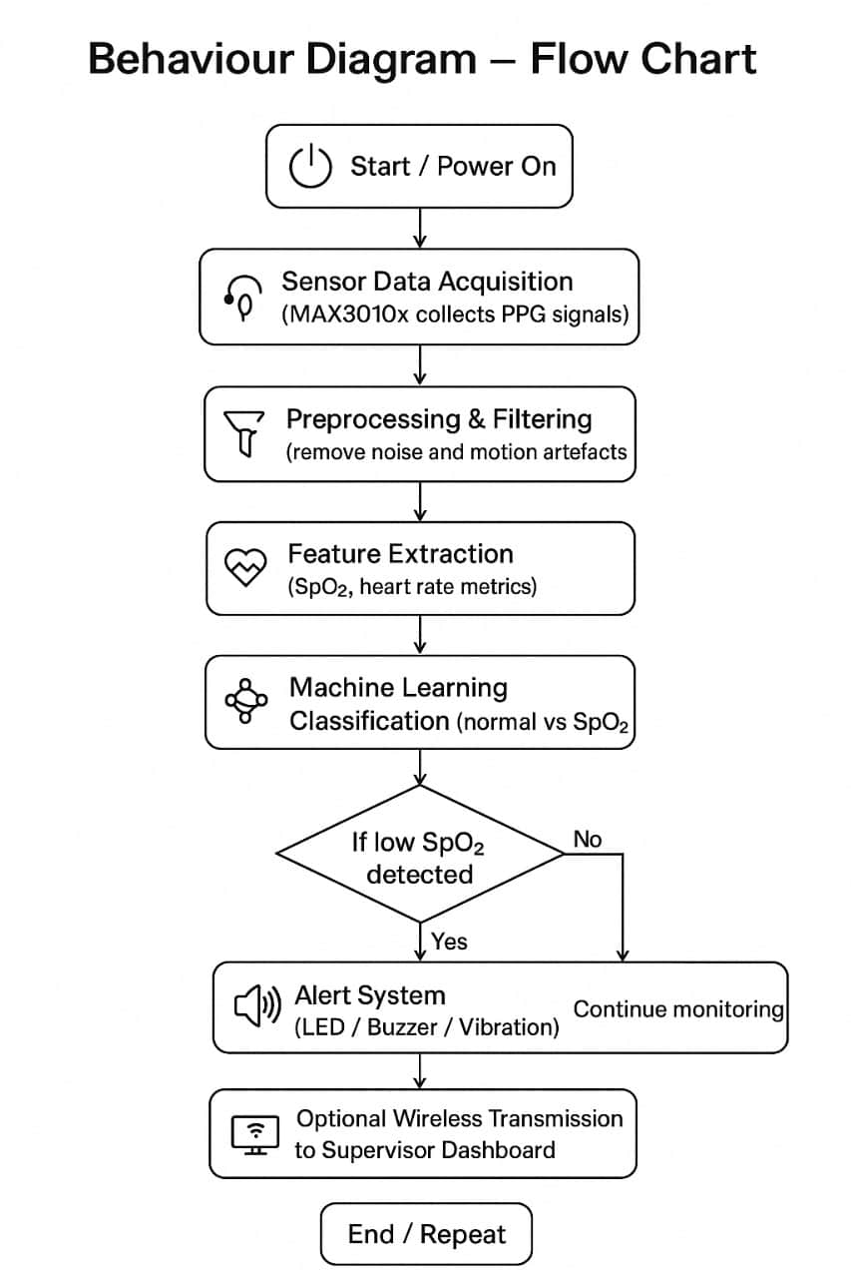
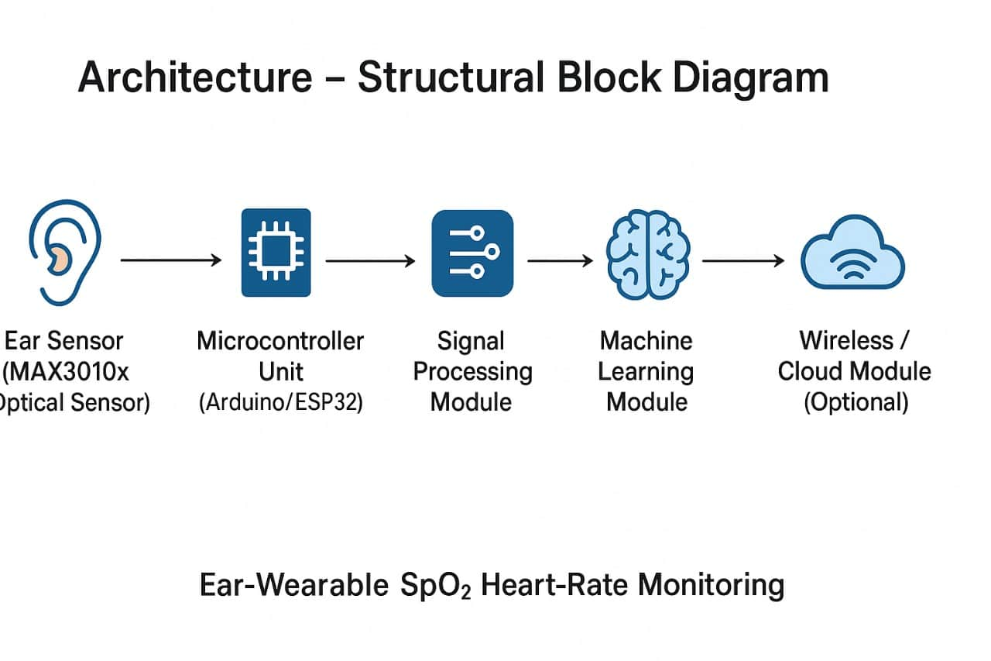
Architecture
Structural Diagram
Block Diagram/Pin Diagram
Behaviour Diagram
Flow chart/ State machine

Slide 8
Use Cases & Testing
Use Cases
Industrial Safety Monitoring: Continuous SpO₂ and heart rate tracking for workers in mines, tunnels, and low-ventilation factories.
Preventive Alerts: Early warning when oxygen saturation drops below safe levels.
Portable Health Device: Comfortable ear-wearable design for real-time monitoring during long shifts.
Data Logging & Analysis: Storing physiological data for supervisors to assess worker health trends.
Research / AI Development: Dataset creation for machine-learning models to improve accuracy of wearable PPG-based devices.
Testing Approach
Hardware Testing: Verify sensor (MAX3010x) accuracy by comparing with a commercial pulse oximeter. Check ear-clip stability and comfort for different users.
Signal Processing Testing: Test filtering methods to remove noise/motion artefacts. Validate feature extraction (SpO₂, heart rate) with sample datasets.
Machine Learning Testing: Train and test models on collected PPG data. Evaluate performance using metrics: accuracy, sensitivity, specificity.
System Testing: Simulate low-oxygen environments and check real-time alert response. Test wireless transmission (if used) for data integrity. Conduct pilot testing with small group of volunteers.

Slide 9
Implementation and Results – Iteration 1
Iteration 1 : Results
Implementation:
Completed detailed literature survey on wearable SpO₂ sensors and ML approaches.
Finalized component selection → MAX30100/30102 sensor + Arduino/ESP32.
Designed system architecture (block diagram + flow chart).
Identified ML approach (classification model for anomaly detection).
Results:
Validated that ear-based SpO₂ monitoring is feasible and more stable than finger sensors (from references).
Confirmed design feasibility for industrial use case.
Reviewed public PPG datasets for training reference.
Defined clear roadmap for hardware setup.

Slide 10
Implementation and Results – Iteration 2
Iteration : Results + Validation against the use cases and test cases
Implementation (Planned):
Integrate MAX30100/30102 with Arduino/ESP32 for live data acquisition.
Apply preprocessing & filtering on raw PPG signals.
Extract features: SpO₂ percentage, heart rate, pulse rate variability.
Implement basic ML classifier for anomaly detection.
Results (Expected):
PPG Signal Dataset Collected → from ear sensor under normal & simulated low-ventilation conditions.
Accuracy Check → SpO₂ values validated against commercial finger oximeter.
Noise Reduction → Filtering improves clarity and stability of PPG waveforms.
Prototype Demonstration → Device gives alert (LED/Buzzer) when SpO₂ < threshold.
Validation Against Use Cases & Test Cases:
The prototype supports continuous worker safety monitoring, provides preventive alerts below safe SpO₂ levels, and ensures portability through an ear-clip design. Validation includes: TC1 – sensor vs finger oximeter (<±2% deviation), TC2 – motion artefacts rejected by filtering/ML, TC3 – low-oxygen simulation triggers alerts, and TC4 – normal conditions show stable readings without false alarms.

Slide 11
Conclusion & Future Work
Conclusion(So Far)
The literature survey confirms the need for continuous SpO₂ and heart-rate monitoring in low-ventilation environments.
Hardware components, including MAX3010x sensor and Arduino/ESP32, have been selected and finalized.
PPG data collection from volunteers has been completed, providing a foundation for ML analysis.
The project is feasible and promising for developing an ear-wearable monitoring device.
Summary of Work Completed
Literature survey and review of existing solutions.
Selection of hardware components for prototype.
Collection of initial PPG data.
Future Work
Run PPG data simulations and extract features for analysis.
Train ML models for noise removal and anomaly detection.
Assemble and test the ear-wearable prototype.
Evaluate device comfort and real-time alert system.
Optimize ergonomic design and consider wireless connectivity for supervisor monitoring.

Slide 12
THANK YOU
Have a Great Day !

